Slide 1
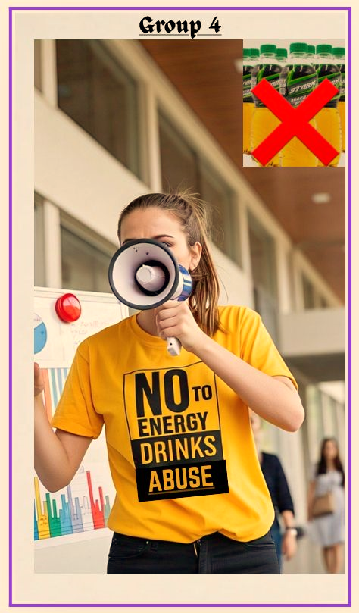
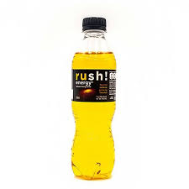
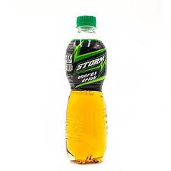
Stop Energy Drink Abuse
GROUP 4
ETHNOPHARMACY

Slide 2
WHAT IS ENERGY DRINK AND IT’S ABUSE?
Energy drink is A high-caffeine,high sugar beverage designed to quickly boost energy, alertness and performance.
Energy drink abuse refers to the excessive consumption of energy drinks often leading to a physical and psychological dependence on their stimulant effects.
This can manifest as a strong craving for the drink, an inability to control consumption despite negative consequences, and withdrawal symptoms when consumption is reduced.

Slide 3
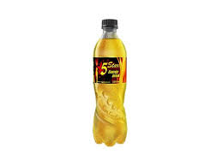
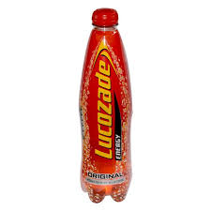
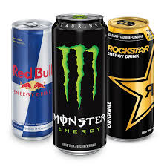
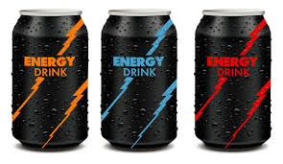
FORMS OF ENERGY DRINKS

Slide 4
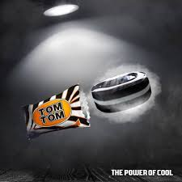
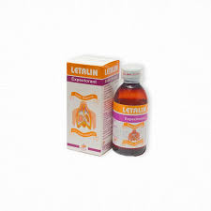
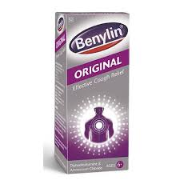
OTHER WAYS PEOPLE ABUSE THESE ENERGY DRINKS

Slide 5

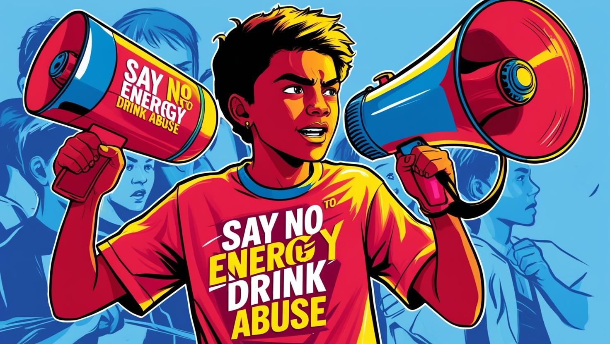
CAMPAIGN OBJECTIVE
To educate university students about
The dangers of excessive energy drink consumption.
To promote healthier alternatives and reduce dependency on high-caffeine beverages for academic performance and social stimulation.

Slide 6

THEME & SLOGAN
“Don’t Burn Out to Power Up”
Fuel Smart, Not Hard: Abuse Steals Tomorrow’s Energy.

Slide 7

WHY THIS CAMPAIGN?
Energy drinks are popular among students who:
Pull all-nighters
Juggle part-time jobs
Need quick energy before exams or workouts
Initial use often starts as a one-time boost.
Regular use can lead to serious health risks.
The campaign’s goal is to:
Expose the hidden dangers of energy drinks Abuse
Inspire real change across campus.

Slide 8
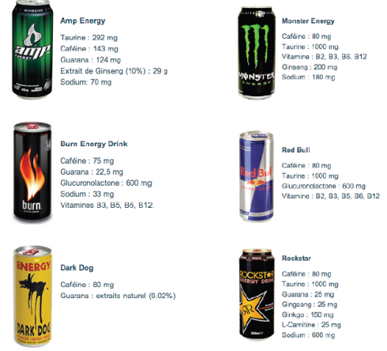

COMPOSITION OF ENERGY DRINKS
Caffeine (up to 500mg per can!) – Main stimulant, easily addictive.
Taurine – Amino acid that affects heart and brain activity, especially risky when paired with caffeine.
Sugar (as high as 27–30g per serving) – Leading to weight gain, insulin resistance, and sugar crashes.
Guarana – Natural caffeine source, adds to total caffeine overload.
B Vitamins – Overdoses can be toxic, causing nerve issues.
Ginseng – May affect blood sugar levels and interfere with medications.
Artificial flavors/preservatives – Long-term consumption raises toxicity levels.

Slide 9
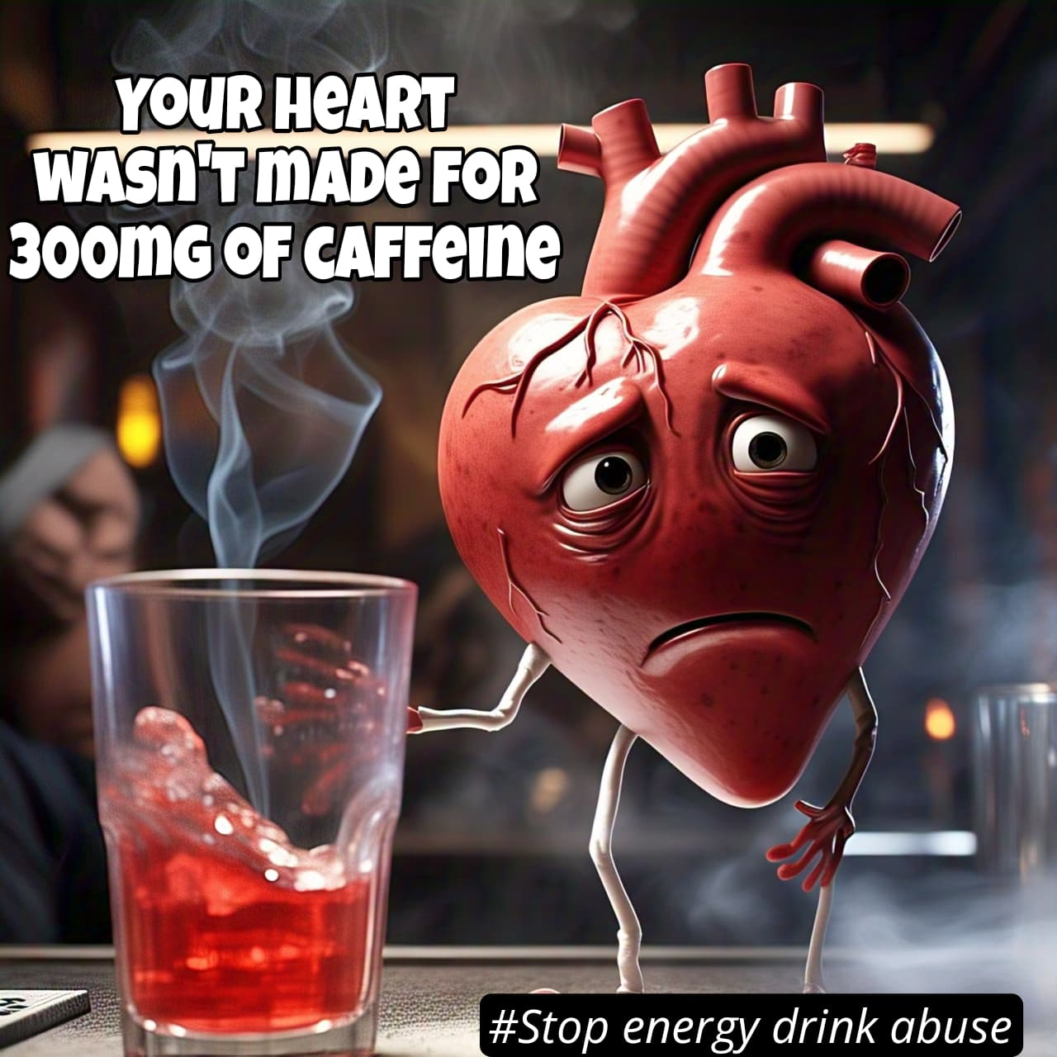
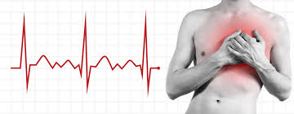
KEY RISKS OF ENERGY DRINK ABUSE
Cardiovascular Issues
Rapid heart rate, high blood pressure, palpitations, and in some cases, arrhythmias.

Slide 10

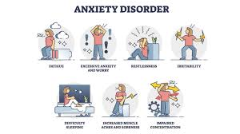
KEY RISKS OF ENERGY DRINK ABUSE
Mental Health Disruption
Anxiety, panic attacks, irritability, and insomnia

Slide 11
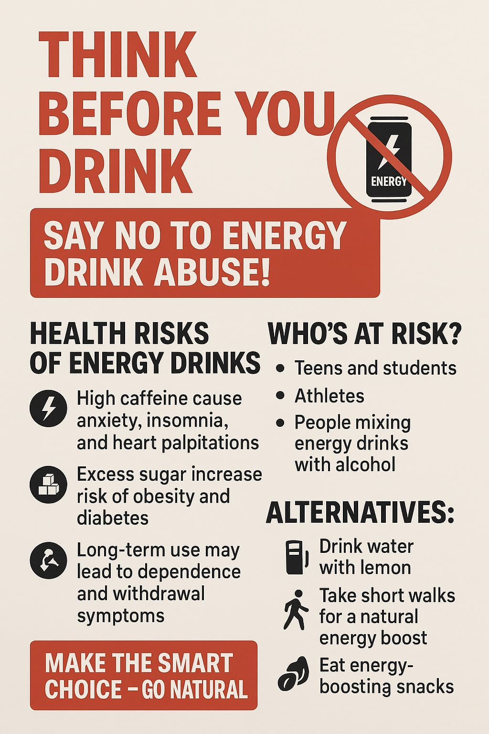

KEY RISKS OF ENERGY DRINK ABUSE
Dependence & Withdrawal
Physical and psychological reliance, headaches, fatigue, and mood swings upon stopping

Slide 12
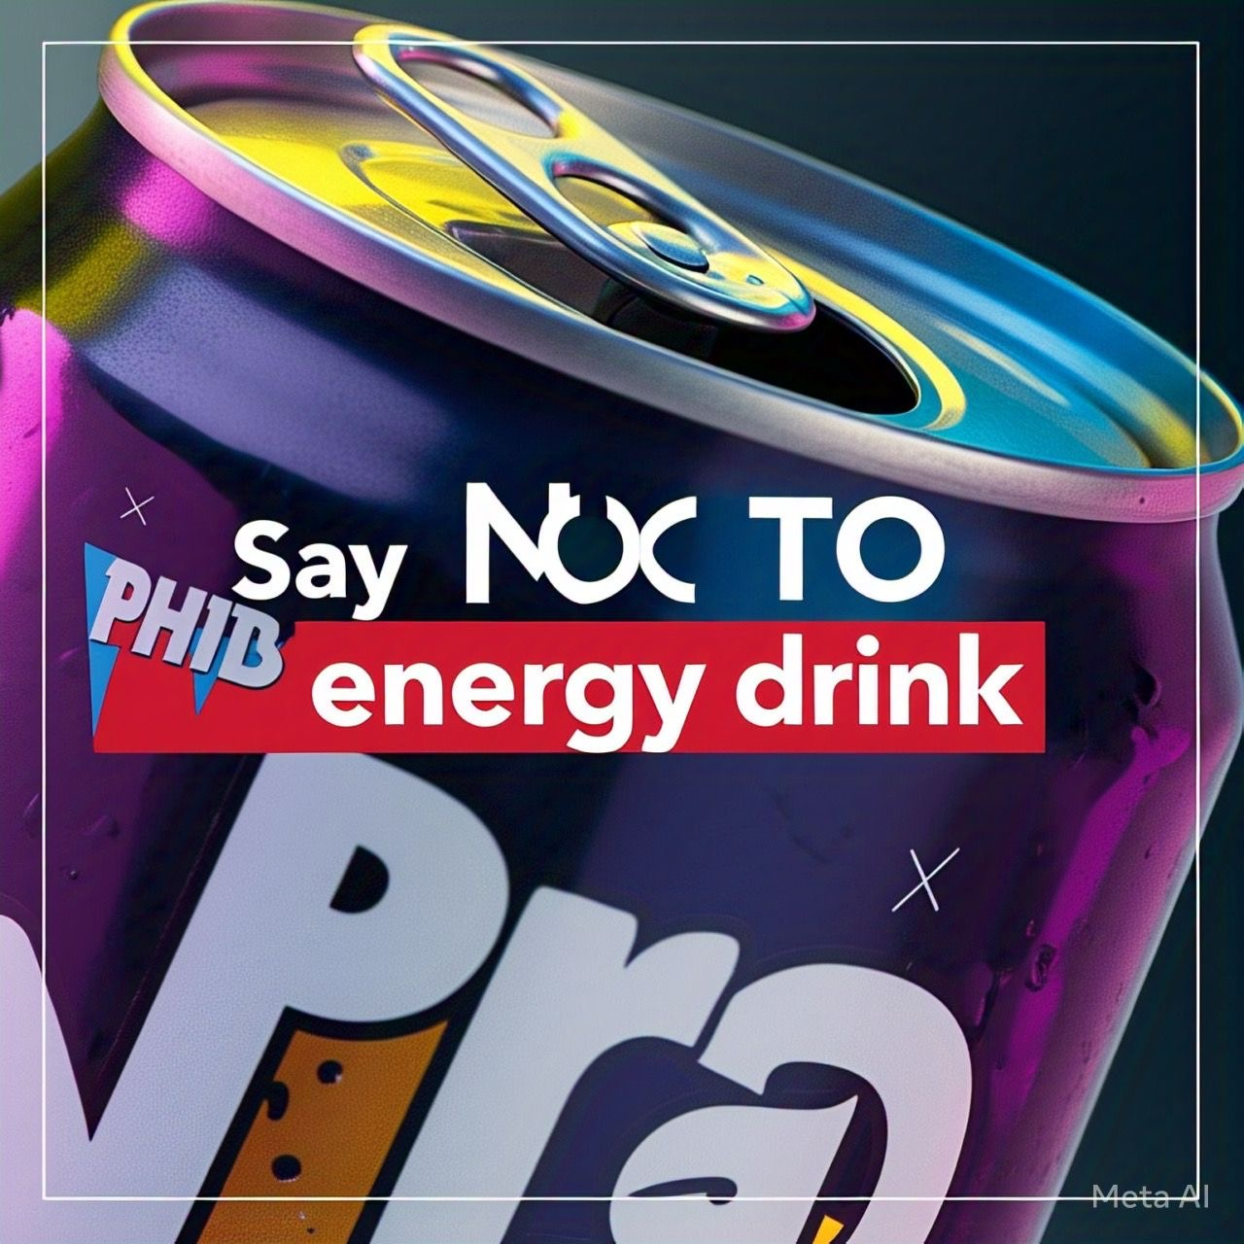
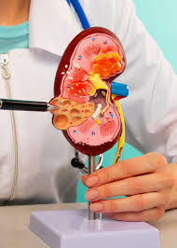
KEY RISKS OF ENERGY DRINK ABUSE
Kidney & Liver Strain
Due to high sugar and chemical additives, especially when combined with other medications or alcohol.

Slide 13
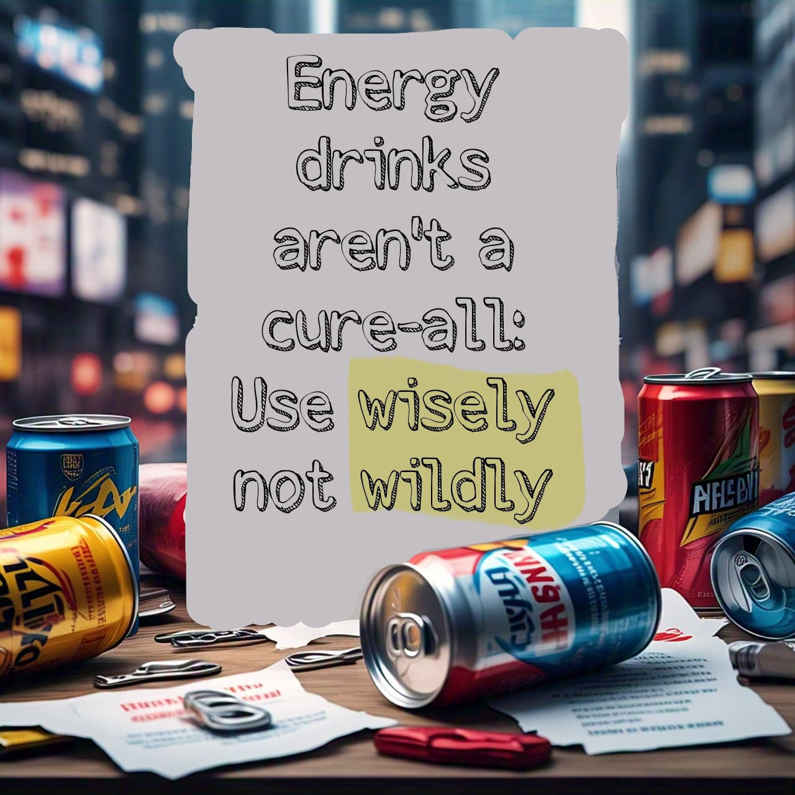
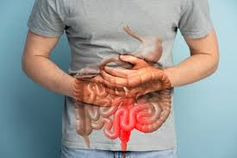
KEY RISKS OF ENERGY DRINK ABUSE
Gastrointestinal Problems
Upset stomach, nausea, and dehydration.

Slide 14

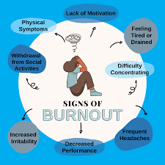

KEY RISKS OF ENERGY DRINK ABUSE
Academic Burnout
False productivity leads to overextension and eventual mental fatigue.

Slide 15

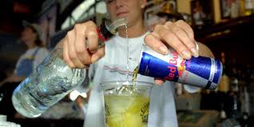
KEY RISKS OF ENERGY DRINK ABUSE
Interactions with Alcohol
Dangerous combo masking signs of intoxication, leading to accidents and risky behaviors.

Slide 16
Measures to Recharge Naturally
Prioritize Good Sleep: Aim for 7–9 hours per night to naturally boost energy.
Stay Hydrated: Drink plenty of water throughout the day.
Manage Stress: Use mindfulness, deep breathing, or quick meditation.
Take Power Naps: A 15–20 minute nap can boost alertness without caffeine.
Plan Smart Breaks: Short, regular study breaks improve focus and prevent burnout.
Exercise Regularly: Light exercise like a brisk walk or stretching can wake up your body and mind.

Slide 17
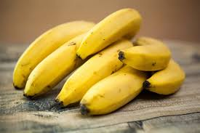
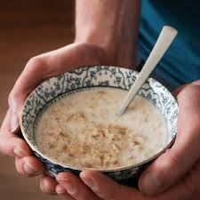
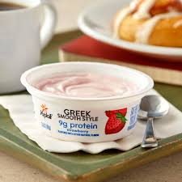
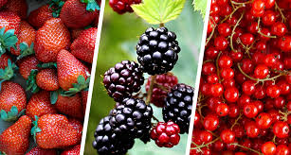
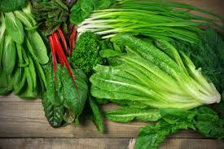
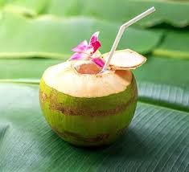
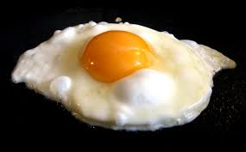
Foods that Naturally Boost Energy:
Bananas.
Oats
Nuts and Seeds
Greek Yogurt
Berries
Eggs
Leafy Greens
Cocoanut

Slide 18

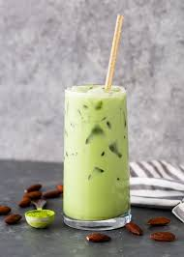

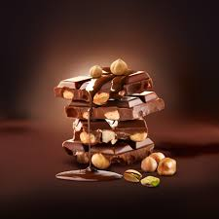
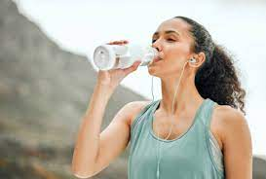
ALTERNATIVES TO ENERGY DRINKS
Green tea or matcha
Coffee (moderate amount)
Smoothies with protein and fruit
Water + electrolytes
Nuts and dark chocolate
Power naps

Slide 19

Take-Home Message
Energy drinks might promise quick energy, but the long-term cost to your health isn’t worth it.
Relying on them can lead to anxiety, heart problems, poor sleep, and even damage your brain’s ability to think clearly.
Real strength comes from balance — not from a can.
Choose rest, healthy foods, and smart study habits instead.
Recharge the right way — because your future deserves better!"

Slide 20


Slide 21
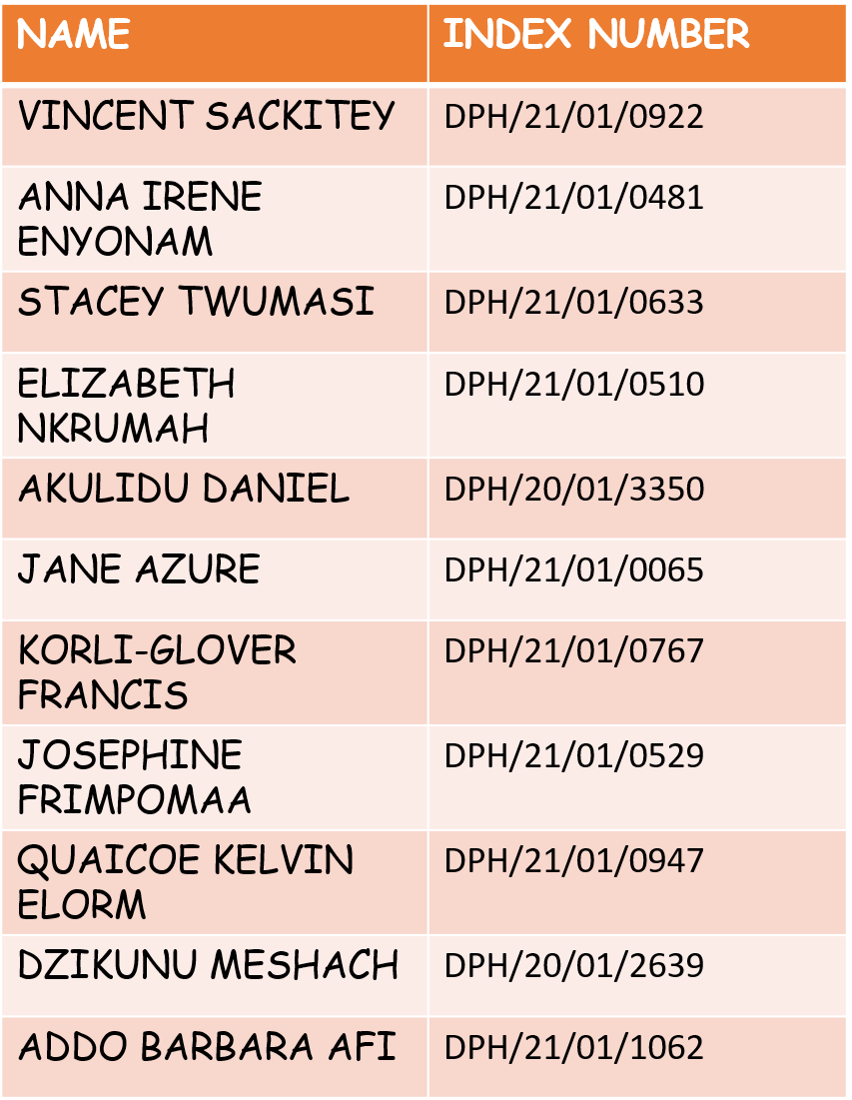
NAMES OF GROUP MEMBERS
NAME | INDEX NUMBER
SAMUEL TANKO | DPH/21/01/0074
OSEI MAINOO FRANK | DPH/21/01/0597
ADU-KUSI ALFRED | DPH/21/01/1314
KEZIA DANIELLE SAPPOR | DPH/21/01/0668
BANA BENJAMIN | DPH/20/01/2984
SAM SANDRA | DPH/21/01/0797
EMMANUEL YARCK | DPH/21/01/0594
NII SOWAH KWASHI | DPH/21/01/0474
PAA KODWO KETU | DPH/21/01/0660

